Slide 1

Deployment models
How to deploy a cloud system ?

Slide 2
Deployment Model
There are four primary cloud deployment models :
Public Cloud
Private Cloud
Community Cloud
Hybrid Cloud
Each can exhibit the previously discussed characteristics; their differences lie primarily in the scope and access of published cloud services, as they are made available to service consumers.

Slide 3
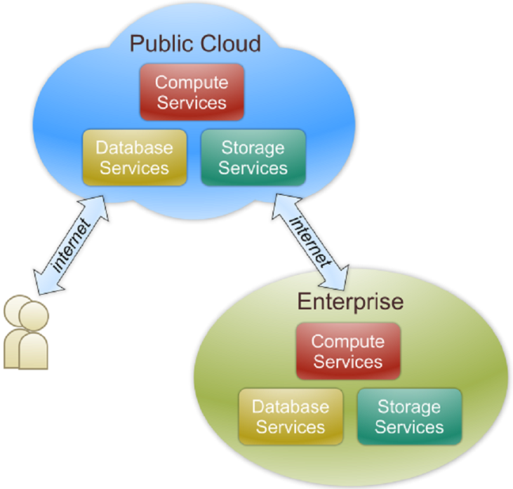
Public Cloud
The cloud infrastructure is made available to the general public or a large industry group and is owned by an organization selling cloud services.
Also known as external cloud or multi-tenant cloud, this model essentially represents a cloud environment that is openly accessible.
From a structural point of view they are a distributed system, most likely composed of one or more data centers connected together, on top of which the specific services offered by the cloud are implemented.
Any customer can easily sign in with the cloud provider, enter her credential and billing details, and use the services offered.

Slide 4
Cont…
A fundamental characteristic of public cloud is multitenancy.
A public cloud is meant to serve a multitude of users, not a single customer.
Any customer requires a virtual computing environment that is separated, and most likely isolated, from other users.
This is a fundamental requirement to provide effective monitoring of user activities and guarantee the desired performance and the other QoS attributes negotiated with users.
QoS management is a very important aspect of public clouds.
Hence, a significant portion of the software infrastructure is devoted to monitoring the cloud resources, to bill them according to the contract made with the user, and to keep a complete history of cloud usage for each customer.
These features are fundamental to public clouds because they help providers offer services to users with full accountability

Slide 5
Cont..
A public cloud can offer any kind of service: infrastructure, platform, or applications.
For example, Amazon EC2 is a public cloud that provides infrastructure as a service; Google AppEngine is a public cloud that provides an application development platform as a service; and SalesForce.com is a public cloud that provides software as a service.
What characterizes them is their natural ability to scale on demand and sustain peak load

Slide 6
Cont..
From an architectural point of view there is no restriction concerning the type of distributed system implemented to support public clouds.
Most likely, one or more data centers constitute the physical infrastructure on top of which the services are implemented and delivered.
Public clouds can be composed of geographically dispersed datacenters to share the load of users and better serve them according to their locations.
For example, Amazon Web Services has datacenters installed in the United States, Europe, Singapore, and Australia;
They allow their customers to choose between three different regions: us-west-1, us-east-1, or eu-west-1.
Such regions are priced differently and are further divided into availability zones, which map to specific datacenters.
According to the specific class of services delivered by the cloud, a different software stack is installed to manage the infrastructure: virtual machine managers, distributed middleware, or distributed applications.

Slide 7
Characteristics
Shared Infrastructure:
Public clouds use a shared infrastructure model, where multiple organizations and users share the same physical hardware and resources, including servers, storage, and networking equipment.
This shared environment allows for cost efficiencies and scalability.
Accessibility:
Public cloud services are accessible to anyone with an internet connection and the necessary credentials.
Users can access these services from virtually anywhere in the world, making them highly accessible and flexible.
Scalability:
Public clouds are designed to be highly scalable.
Users can easily provision additional resources, such as virtual machines, storage, and databases, to meet their changing computing needs.
This scalability is often referred to as "elasticity."

Slide 8
Pay-as-You-Go Pricing:
Public cloud providers typically use a pay-as-you-go or subscription-based pricing model.
Users are billed based on their actual usage of resources, which can help reduce capital expenditures and allow for cost optimization.
Managed Services:
Public cloud providers offer a wide range of managed services, including computing, storage, databases, machine learning, analytics, and more.
These services abstract much of the underlying infrastructure management, allowing users to focus on application development and functionality.
Security and Compliance:
Public cloud providers invest heavily in security measures to protect their infrastructure and customer data.
They often provide tools and services to help users enhance their own security and compliance efforts.

Slide 9
Global Reach:
Public cloud providers operate data centers in multiple regions and countries around the world.
This global reach enables users to deploy applications and services in proximity to their target audiences for improved performance and redundancy.
Self-Service:
Users can provision and manage resources in public clouds through web-based consoles or APIs.
This self-service nature allows for quick deployment and flexibility in managing resources.
Resource Sharing:
While the shared infrastructure offers cost benefits, it also means that users share resources with others.
Cloud providers use virtualization and resource allocation techniques to ensure isolation and performance predictability

Slide 10
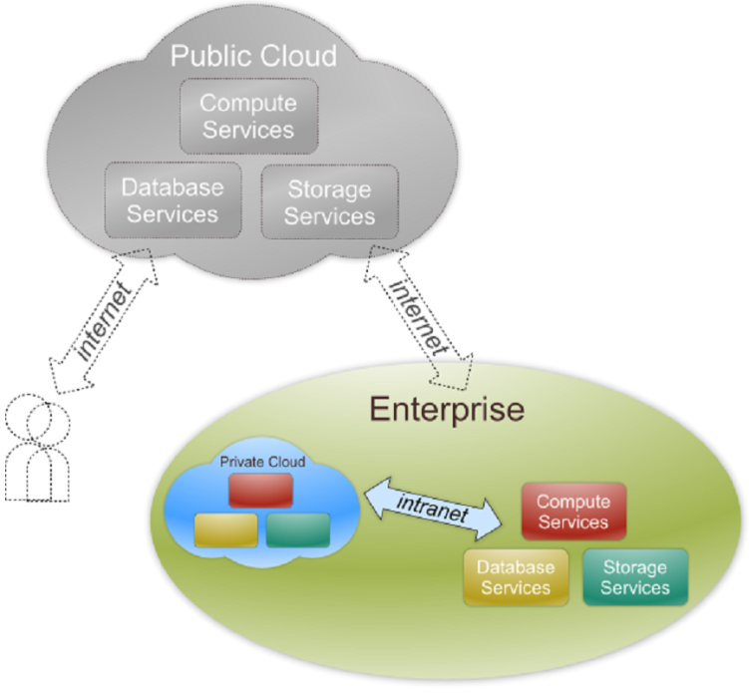
Private Cloud
The cloud infrastructure is operated solely for an organization. It may be managed by the organization or a third party and may exist on premise or off premise.
Also referred to as internal cloud or on-premise cloud, a private cloud intentionally limits access to its resources to service consumers that belong to the same organization that owns the cloud.
Basic characteristics :
Heterogeneous infrastructure
Customized and tailored policies
Dedicated resources
In-house infrastructure
End-to-end control

Slide 11
Reasons for using Private Cloud
In the case of public clouds, the provider is in control of the infrastructure and, eventually, of the customers’ core logic and sensitive data.
Even though there could be regulatory procedure in place that guarantees fair management and respect of the customer’s privacy, this condition can still be perceived as a threat or as an unacceptable risk that some organizations are not willing to take.
In particular, institutions such as government and military agencies will not consider public clouds as an option for processing or storing their sensitive data.
The risk of a breach in the security infrastructure of the provider could expose such information to others; this could simply be considered unacceptable.
In other cases, the loss of control of where your virtual IT infrastructure resides could open the way to other problematic situations.
More precisely, the geographical location of a datacenter generally determines the regulations that are applied to management of digital information.
As a result, according to the specific location of data, some sensitive information can be made accessible to government agencies or even considered outside the law if processed with specific cryptographic techniques

Slide 12
Reasons for using Private Cloud
Finally, existing enterprises that have large computing infrastructures or large installed bases of software do not simply want to switch to public clouds, but they use the existing IT resources and optimize their revenue.
All these aspects make the use of a public computing infrastructure not always possible.
Yet the general idea supported by the cloud computing vision can still be attractive.
More specifically, having an infrastructure able to deliver IT services on demand can still be a winning solution, even when implemented within the private premises of an institution.
This idea led to the diffusion of private clouds, which are similar to public clouds, but their resource-provisioning model is limited within the boundaries of an organization.

Slide 13
Private clouds are virtual distributed systems that rely on a private infrastructure and provide internal users with dynamic provisioning of computing resources.
Instead of a pay-as-you-go model as in public clouds, there could be other schemes in place, taking into account the usage of the cloud and proportionally billing the different departments or sections of an enterprise.
Private clouds have the advantage of keeping the core business operations in-house by relying on the existing IT infrastructure.
In this scenario, security concerns are less critical, since sensitive information does not flow out of the private infrastructure.
Moreover, existing IT resources can be better utilized because the private cloud can provide services to a different range of users.

Slide 14
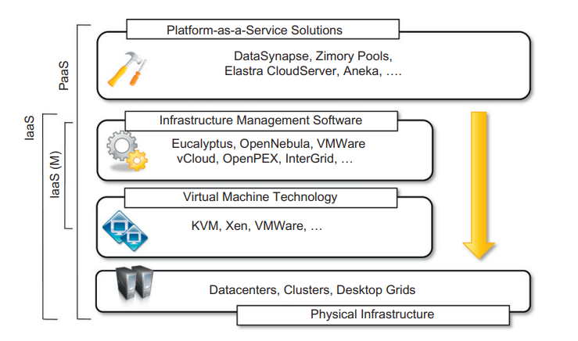
How to Implement Private Cloud
Different options can be adopted to implement private clouds.
Figure provides a comprehensive view of the solutions together with some reference to the most popular software used to deploy private clouds.
At the bottom layer of the software stack, virtual machine technologies such as Xen, KVM , and VMware serve as the foundations of the cloud.
Virtual machine management technologies such as VMware vCloud, Eucalyptus , and OpenNebula can be used to control the virtual infrastructure and provide an IaaS solution.
VMware vCloud is a proprietary solution, but Eucalyptus provides full compatibility with Amazon Web Services interfaces and supports different virtual machine technologies such as Xen, KVM, and VMware.

Slide 15
PaaS solutions can provide an additional layer and deliver a high level service for private clouds.
Among the options available for private deployment of clouds we can consider DataSynapse, Zimory Pools, Elastra, and Aneka.
DataSynapse is a global provider of application virtualization software. By relying on the VMware virtualization technology, DataSynapse provides a flexible environment for building private clouds on top of datacenters.
Aneka is a software development platform that can be used to deploy a cloud infrastructure on top of heterogeneous hardware: datacenters, clusters, and desktop grids.
It provides a pluggable service-oriented architecture that’s mainly devoted to supporting the execution of distributed applications with different programming models: bag of tasks, MapReduce, and others.

Slide 16
Characteristics
Dedicated Resources:
Private clouds offer dedicated computing resources, including servers, storage, and networking, to a single organization.
This ensures that the organization has exclusive control over these resources.
Isolation:
Private clouds provide a high level of isolation and security.
Since the infrastructure is not shared with other organizations, the risk of data leakage and security breaches is reduced.
Customization:
Organizations have greater flexibility to customize and configure their private cloud environments to meet their specific needs, including hardware, software, and security policies.

Slide 17
Control:
Private cloud users have full control over the infrastructure and can define their own management and security policies.
This level of control is particularly important for organizations with strict regulatory compliance requirements.
Security and Compliance:
Private clouds are often chosen by organizations with stringent security and compliance requirements, such as those in the healthcare, financial, or government sectors.
They can implement their own security measures and compliance standards.
Ownership:
In the case of on-premises private clouds, the organization owns and maintains the physical hardware and infrastructure.
In hosted private clouds, a third-party provider manages the infrastructure but dedicates it exclusively to the organization.
Legacy System Integration:
Private clouds can be used to integrate with legacy systems and applications that may not be easily migrated to a public cloud environment.

Slide 18
Public vs. Private
Comparison :
 | Public Cloud | Private Cloud
Infrastructure | Homogeneous | Heterogeneous
Policy Model | Common defined | Customized & Tailored
Resource Model | Shared & Multi-tenant | Dedicated
Cost Model | Operational expenditure | Capital expenditure
Economy Model | Large economy of scale | End-to-end control

Slide 19
Hybrid Cloud
Public clouds are large software and hardware infrastructures that have a capability that is huge enough to serve the needs of multiple users, but they suffer from security threats and administrative pitfalls.
Although the option of completely relying on a public virtual infrastructure is appealing for companies that did not incur IT capital costs and have just started considering their IT needs (i.e., start-ups), in most cases the private cloud option prevails because of the existing IT infrastructure.
Private clouds are the perfect solution when it is necessary to keep the processing of information within an enterprise’s premises or it is necessary to use the existing hardware and software infrastructure.
One of the major drawbacks of private deployments is the inability to scale on demand and to efficiently address peak loads.
In this case, it is important to leverage capabilities of public clouds as needed.
Hence, a hybrid solution could be an interesting opportunity for taking advantage of the best of the private and public worlds.
This led to the development and diffusion of hybrid clouds

Slide 20
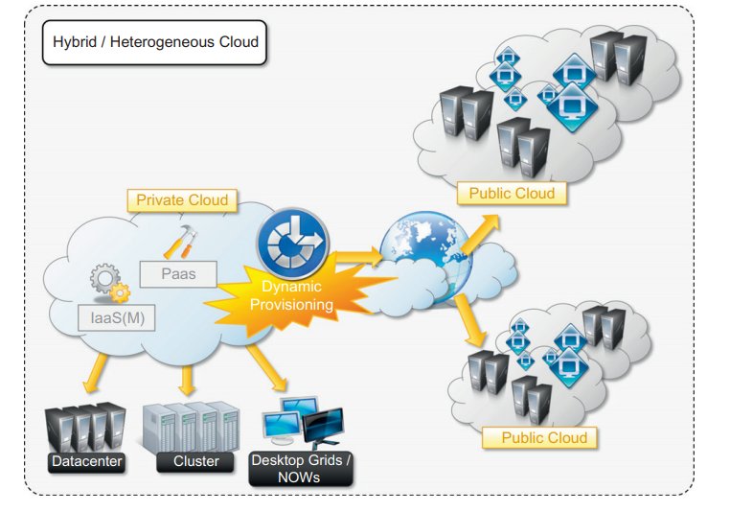
Hybrid clouds allow enterprises to exploit existing IT infrastructures, maintain sensitive information within the premises, and naturally grow and shrink by provisioning external resources and releasing them when they’re no longer needed.
Security concerns are then only limited to the public portion of the cloud that can be used to perform operations with less stringent constraints but that are still part of the system workload.
Fig provides a general overview of a hybrid cloud: It is a heterogeneous distributed system resulting from a private cloud that integrates additional services or resources from one or more public clouds.
For this reason they are also called heterogeneous clouds.
As depicted in the diagram, dynamic provisioning is a fundamental component in this scenario.
Hybrid clouds address scalability issues by leveraging external resources for exceeding capacity demand. These resources or services are temporarily leased for the time required and then released. This practice is also known as cloudbursting

Slide 21
Whereas the concept of hybrid cloud is general, it mostly applies to IT infrastructure rather than software services.
In an IaaS scenario, dynamic provisioning refers to the ability to acquire on demand virtual machines in order to increase the capability of the resulting distributed system and then release them.
In particular, with respect to private clouds, dynamic provisioning introduces a more complex scheduling algorithm and policies, the goal of which is also to optimize the budget spent to rent public resources.
Infrastructure management software such as OpenNebula already exposes the capability of integrating resources from public clouds such as Amazon EC2.
What require is that an advanced scheduling engine that’s able to differentiate these resources and provide smart allocations by taking into account the budget available to extend the existing infrastructure.
In the case of OpenNebula, advanced schedulers such as Haizea can be integrated to provide cost-based scheduling

Slide 22
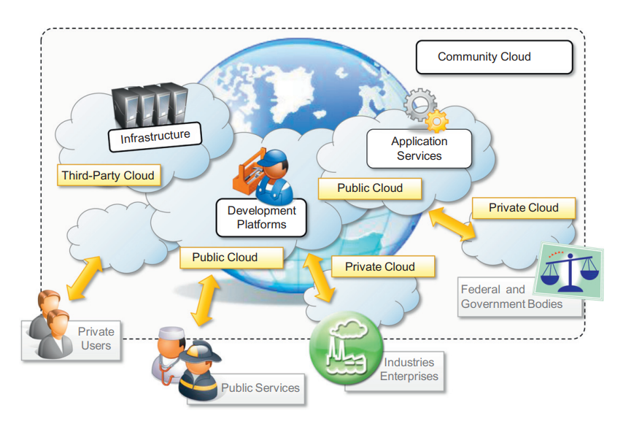
Community Cloud
Community clouds are distributed systems created by integrating the services of different clouds to address the specific needs of an industry, a community, or a business sector.
A community cloud is formed by harnessing the underutilized resources of user machines and providing an infrastructure in which each can be at the same time a consumer, a producer, or a coordinator of the services offered by the cloud.
The users of a specific community cloud fall into a well-identified community, sharing the same concerns or needs; they can be government bodies, industries, or even simple users, but all of them focus on the same issues for their interaction with the cloud.
This is a different scenario than public clouds, which serve a multitude of users with different needs.
Community clouds are also different from private clouds, where the services are generally delivered within the institution that owns the cloud

Slide 23
Candidate sectors for community clouds
Media industry:
In the media industry, companies are looking for low-cost, agile, and simple solutions to improve the efficiency of content production.
Most media productions involve an extended ecosystem of partners.
In particular, the creation of digital content is the outcome of a collaborative process that includes movement of large data, massive compute-intensive tasks, and complex workflow executions.
Community clouds can provide a shared environment where services can facilitate business-to-business collaboration and offer the horsepower in terms of aggregate bandwidth, CPU, and storage required to efficiently support media production.
• Healthcare industry:
In the healthcare industry, there are different scenarios in which community clouds could be of use.
In particular, community clouds can provide a global platform on which to share information and knowledge without revealing sensitive data maintained within the private infrastructure.
The naturally hybrid deployment model of community clouds can easily support the storing of patient-related data in a private cloud while using the shared infrastructure for noncritical services and automating processes within hospitals.

Slide 24
Candidate sectors for community clouds(Cont..)
• Public sector:
Legal and political restrictions in the public sector can limit the adoption of public cloud offerings.
Moreover, governmental processes involve several institutions and agencies and are aimed at providing strategic solutions at local, national, and international administrative levels.
They involve business-to-administration, citizen-to-administration, and possibly business-to-business processes.
Some examples include invoice approval, infrastructure planning, and public hearings.
A community cloud can constitute the optimal venue to provide a distributed environment in which to create a communication platform for performing such operations.
• Scientific research:
Science clouds are an interesting example of community clouds.
In this case, the common interest driving different organizations sharing a large distributed infrastructure is scientific computing.

Slide 25
Benefits of Community Cloud
A community cloud is formed by harnessing the underutilized resources of user machines and providing an infrastructure in which each can be at the same time a consumer, a producer, or a coordinator of the services offered by the cloud.
The benefits of these community clouds are the following:
Openness:
By removing the dependency on cloud vendors, community clouds are open systems in which fair competition between different solutions can happen.
• Scalability:
Being based on a collective that provides resources and services, the infrastructure turns out to be more scalable because the system can grow simply by expanding its user base.

Slide 26
Graceful failures:
Since there is no single provider or vendor in control of the infrastructure, there is no single point of failure.
• Convenience and control:
Within a community cloud there is no conflict between convenience and control because the cloud is shared and owned by the community, which makes all the decisions through a collective democratic process.
• Environmental sustainability:
The community cloud is supposed to have a smaller carbon footprint because it harnesses underutilized resources.

Slide 27
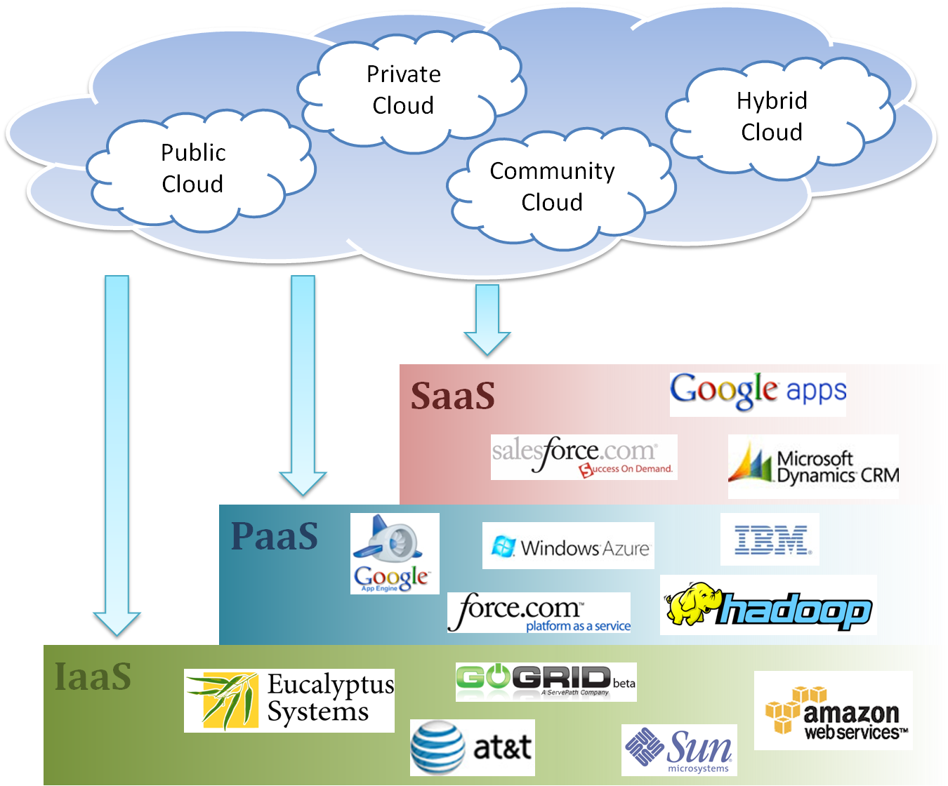
Cloud Ecosystem

Slide 28
Economics of Cloud
The main drivers of cloud computing are economy of scale and simplicity of software delivery and its operation.
In fact, the biggest benefit of this phenomenon is financial: the pay-as-you-go model offered by cloud providers.
In terms of the pricing models introduced by cloud computing, we can distinguish three different strategies that are adopted by the providers:
• Tiered pricing:
In this model, cloud services are offered in several tiers, each of which offers a fixed computing specification and SLA at a specific price per unit of time.
This model is used by Amazon for pricing the EC2 service, which makes available different server configurations in terms of computing capacity (CPU type and speed, memory) that have different costs per hour.

Slide 29
Cont..
• Per-unit pricing:
This model is more suitable to cases where the principal source of revenue for the cloud provider is determined in terms of units of specific services, such as data transfer and memory allocation.
In this scenario customers can configure their systems more efficiently according to the application needs.
This model is used, for example, by GoGrid, which makes customers pay according to RAM/hour units for the servers deployed in the GoGrid cloud.
• Subscription-based pricing:
This is the model used mostly by SaaS providers in which users pay a periodic subscription fee for use of the software or the specific component services that are integrated in their applications.

Slide 30
Open Challenge in Cloud Computing (Cloud interoperability and standards)
Cloud computing is a service-based model for delivering IT infrastructure and applications like utilities such as power, water, and electricity.
To fully realize this goal, introducing standards and allowing interoperability between solutions offered by different vendors are objectives of fundamental importance.
Vendor lock-in constitutes one of the major strategic barriers against the seamless adoption of cloud computing at all stages.
Vendor lock-in can prevent a customer from switching to another competitor’s solution, or when this is possible, it happens at considerable conversion cost and requires significant amounts of time.
This can occur either because the customer wants to find a more suitable solution for customer needs or because the vendor is no longer able to provide the required service.
The presence of standards that are actually implemented and adopted in the cloud computing community could give room for interoperability and then lessen the risks resulting from vendor lock-in.

Slide 31
The current state of standards and interoperability in cloud computing resembles the early Internet era, when there was no common agreement on the protocols and technologies used and each organization had its own network.
Yet the first steps toward a standardization process have been made, and a few organizations, such as the Cloud Computing Interoperability Forum (CCIF) the Open Cloud Consortium and the DMTF Cloud Standards Incubator are leading the path.
The standardization efforts are mostly concerned with the lower level of the cloud computing architecture, which is the most popular and developed.

Slide 32
Open Challenge in Cloud Computing (Scalability and fault tolerance)
The ability to scale on demand constitutes one of the most attractive features of cloud computing.
Clouds allow scaling beyond the limits of the existing in-house IT resources, whether they are infrastructure (compute and storage) or applications services.
To implement such a capability, the cloud middleware has to be designed with the principle of scalability along different dimensions in mind—for example, performance, size, and load.
The cloud middleware manages a huge number of resource and users, which rely on the cloud to obtain the horsepower that they cannot obtain within the premises without bearing considerable administrative and maintenance costs.
These costs are a reality for whomever develops, manages, and maintains the cloud middleware and offers the service to customers.
In this scenario, the ability to tolerate failure becomes fundamental, sometimes even more important than providing an extremely efficient and optimized system.
Hence, the challenge in this case is designing highly scalable and fault-tolerant systems that are easy to manage and at the same time provide competitive performance.

Slide 33
Open Challenge in Cloud Computing (Security, trust, and privacy)
Security, trust, and privacy issues are major obstacles for massive adoption of cloud computing.
The traditional cryptographic technologies are used to prevent data tampering and access to sensitive information.
The massive use of virtualization technologies exposes the existing system to new threats, which previously were not considered applicable.
For example, it might be possible that applications hosted in the cloud can process sensitive information; such information can be stored within a cloud storage facility using the most advanced technology in cryptography to protect data and then be considered safe from any attempt to access it without the required permissions.
Although these data are processed in memory, they must necessarily be decrypted by the legitimate application, but since the application is hosted in a managed virtual environment it becomes accessible to the virtual machine manager that by program is designed to access the memory pages of such an application.
In this case, what is experienced is a lack of control over the environment in which the application is executed, which is made possible by leveraging the cloud.
It then happens that a new way of using existing technologies creates new opportunities for additional threats to the security of applications.
The lack of control over their own data and processes also poses severe problems for the trust we give to the cloud service provider and the level of privacy we want to have for our data

Slide 34
Open Challenge in Cloud Computing (Organizational aspects)
Cloud computing introduces a significant change in the way IT services are consumed and managed.
More precisely, storage, compute power, network infrastructure, and applications are delivered as metered services over the Internet.
Some interesting questions arise in considering the role of the IT department in this new scenario.
In particular, the following questions have to be considered:
• What is the new role of the IT department in an enterprise that completely or significantly relies on the cloud?
• How will the compliance department perform its activity when there is a considerable lack of control over application workflows?
• What are the implications (political, legal, etc.) for organizations that lose control over some aspects of their services?
• What will be the perception of the end users of such services?

Slide 35
From an organizational point of view, the lack of control over the management of data and processes poses not only security threats but also new problems that previously did not exist.
Traditionally, when there was a problem with computer systems, organizations developed strategies and solutions to cope with them, often by relying on local expertise and knowledge.
One of the major advantages of moving IT infrastructure and services to the cloud is to reduce or completely remove the costs related to maintenance and support.
As a result, users of such infrastructure and services lose a reference to deal with for IT troubleshooting.
At the same time, the existing IT staff is required to have a different kind of competency and, in general, fewer skills, thus reducing their value.
These are the challenges from an organizational point of view that must be faced and that will significantly change the relationships within the enterprise itself among the various groups of people working together

Slide 36
Summary
What is cloud computing in your mind
Clear or Cloudy?
Cloud computing is a new paradigm shift of computing
Cloud computing can provide high quality of properties and characteristics based on essentially central ideas
Service models and deployment models provide services that can be used to
Rent fundamental computing resources
Deploy and develop customer-created applications on clouds
Access provider’s applications over network (wired or wireless)

